Slide 1
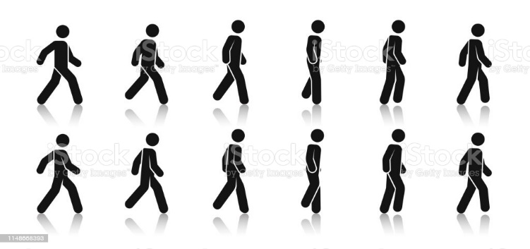

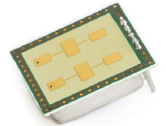
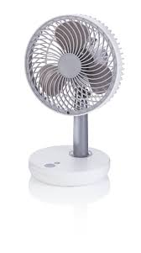

Option Micro-Doppler-Evaluation
Meaning of «Micro-Doppler»
(https://www.mathworks.com/help/phased/ug/introduction-to-micro-doppler-effects.html)
A moving target introduces a frequency shift in the radar return due to Doppler effect.
However, because most targets are not rigid bodies, there are often other vibrations
and rotations in different parts of the target in addition to the platform movement. For
example, when a helicopter flies, its blades rotate, or when a person walks, their arms
swing naturally. These micro scale movements produce additional Doppler shifts,
referred to as micro-Doppler effects, which are useful in identifying target features.
Some questions in CW-Radar signal processing
Can the steps of a person be detected in the radar signal?
Is a human / non-human presence detector realizable?
How fast rotate the blades of a fan / drone / …?

Slide 2
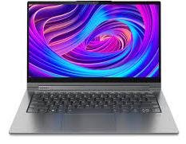
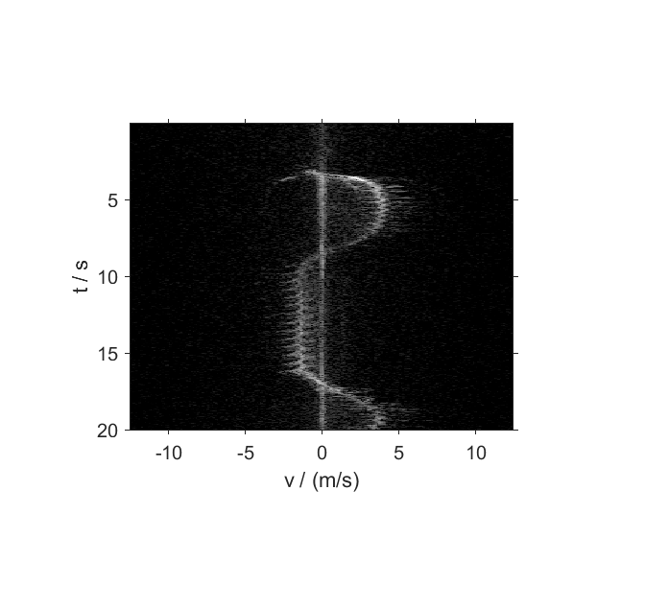
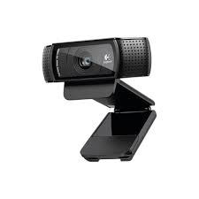
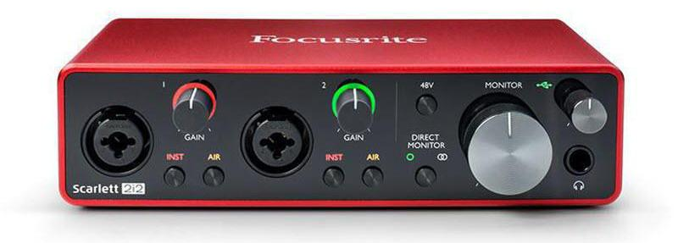

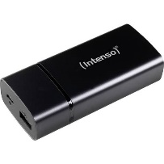
Setup for Micro-Doppler Evaluation
Matlab (or Python)
sampling (audio) signals with f_{s} = 48 kSps (or 44.1 kSps)
resampling to 4, 6, 8, 9.6, 12 or 16 kSps according need
record to wav-file & offline-computation of «spectrogram»
alternatively, online-computation (live-mode)
option: synch with video sequence
ASIO driver
Notebook (or Smartphone)
USB
Q(t)
Instruments-Inputs (not XLR!)
I(t)
Sensor-Board
(without MCU-Board)
5V

Slide 3
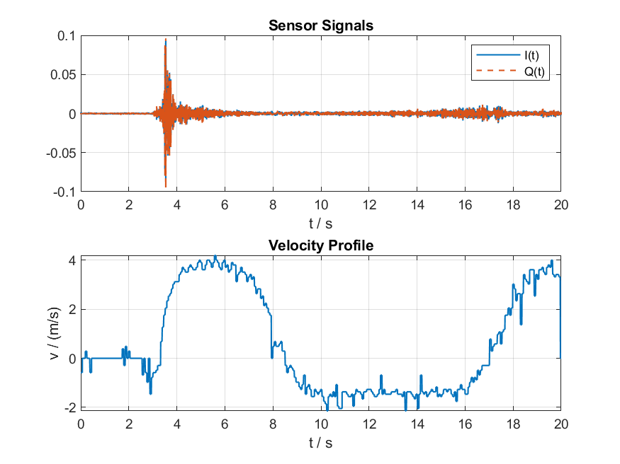
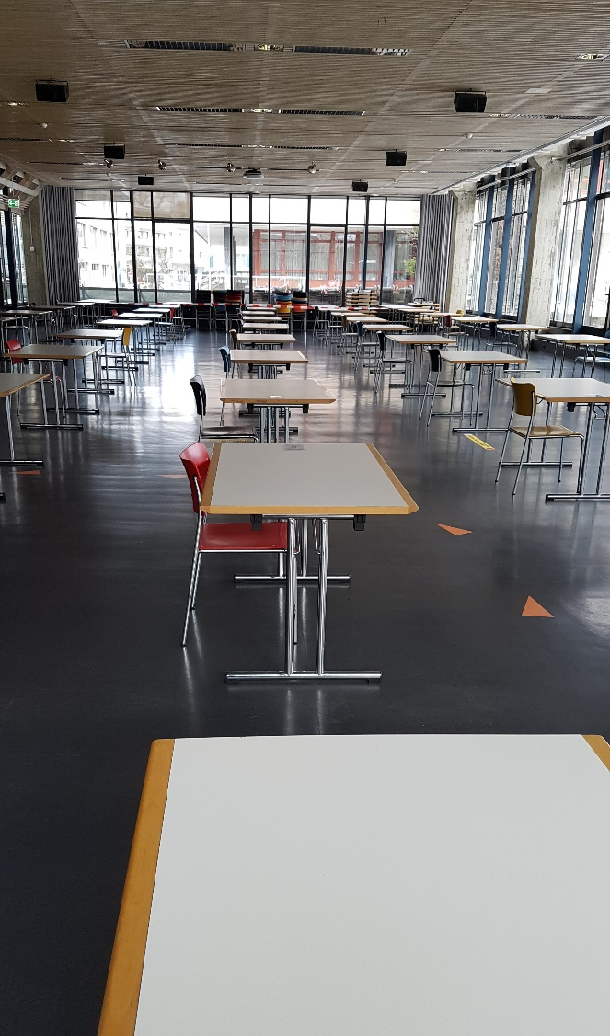
Results of a field test
Δv = 0.1 ms
IvI > 0.2 ms
Jogging &
arm swinging?
fast walking
sw: -60…0 dBc
Radar K-LC6, 60 dB Gain, USB-Audio-Interface
(f_{s} = 4 kSps, N_{FFT} = 256, hanning-window)

